Slide 1
Mechatronic Machine Design (MMD)
Exercise 2
Deadline Jan 23, 2024, 9:00 am
Late submission Jan 30, 2024, 09:00

Slide 2
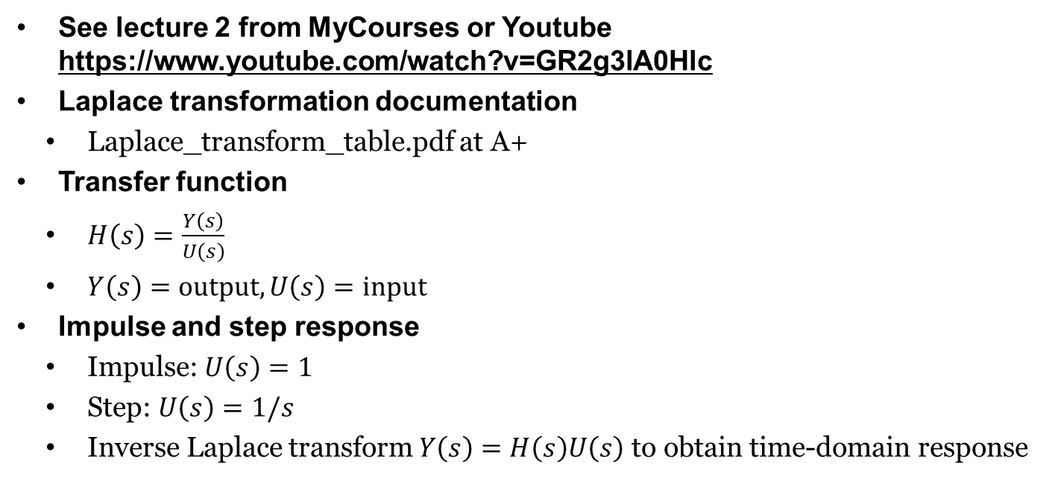
Exerciese 1
See lecture 2 from MyCourses or Youtube https://www.youtube.com/watch?v=GR2g3lA0Hlc
Laplace transformation documentation
Laplace_transform_table.pdf at A+
Transfer function
$H\left(s\right)=\frac{Y\left(s\right)}{U\left(s\right)}$
$Y\left(s\right)=\text{output}, U\left(s\right)=\text{input}$
Impulse and step response
Impulse: $U\left(s\right)=1$
Step: $U\left(s\right)=1/s$
Inverse Laplace transform $Y\left(s\right)=H\left(s\right)U\left(s\right)$ to obtain time-domain response

Slide 3


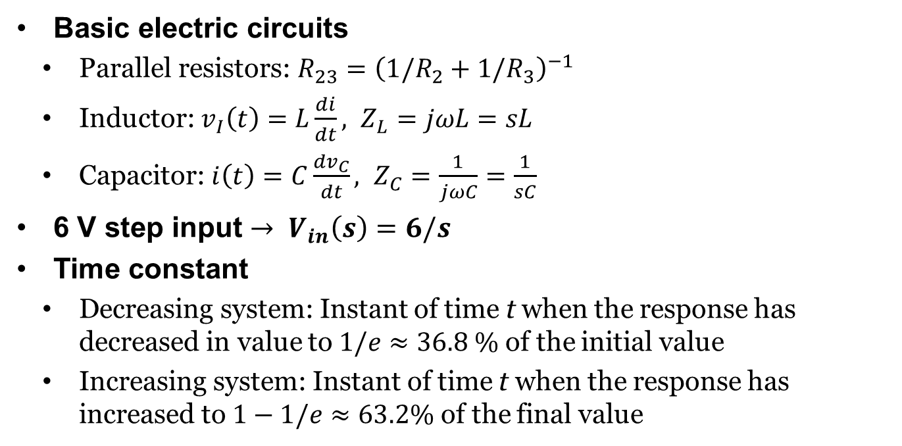
Exercise 2
Basic electric circuits
Parallel resistors: $R_{23}={\left(1/R_{2}+1/R_{3}\right)}^{−1}$
Inductor: ${v_{I}\left(t\right)=L\frac{di}{dt}, Z}_{L}=jωL=sL$
Capacitor: $i\left(t\right)=C\frac{dv_{C}}{dt}, Z_{C}=\frac{1}{jωC}=\frac{1}{sC}$
6 V step input $→ V_{in}\left(s\right)=6/s$
Time constant
Decreasing system: Instant of time t when the response has decreased in value to $1/e≈36.8 \%$ of the initial value
Increasing system: Instant of time t when the response has increased to $1−1/e≈63.2\%$ of the final value
$$i\left(t\right)$$
L
$$i\left(t\right)$$
C

Slide 4
Exercise 3
Build a Simulink model of an electric motor
Equations, motor specifications and reference plot are given in the Hint
It will take some time for the grader
The Signal Builder block has been replaced by Signal Editor
However, the grader requires the use of the legacy Signal Builder block
Copy-paste the Signal Builder block to your model from signal_builder_mmd.slx file

Slide 5
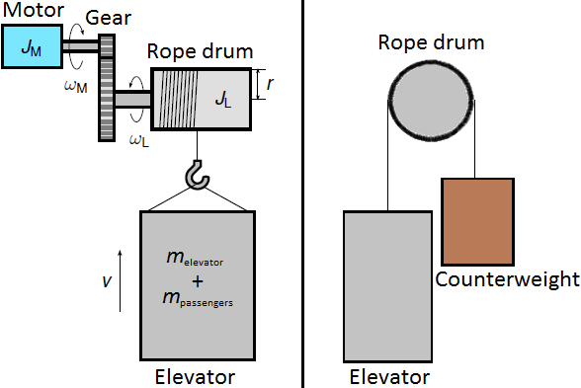
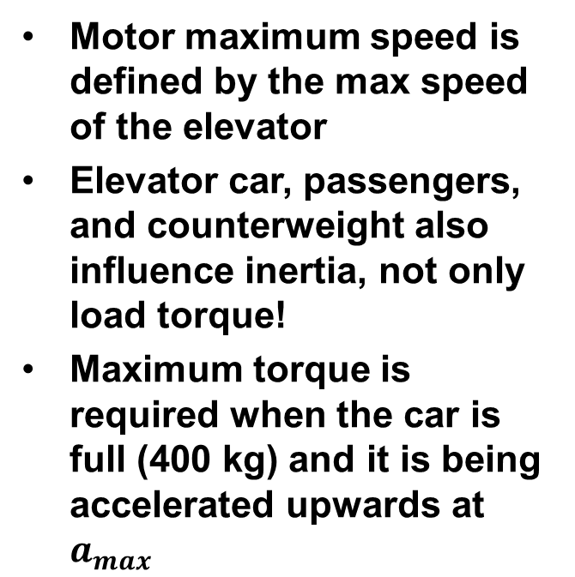
Exercise 4
Motor maximum speed is defined by the max speed of the elevator
Elevator car, passengers, and counterweight also influence inertia, not only load torque!
Maximum torque is required when the car is full (400 kg) and it is being accelerated upwards at $a_{max}$

Slide 6
Exercise 5
Coupling the elevator with the electric motor in Simulink
eq_inertia_torque.slx found in the template zip-file
calculates the motor side equivalent inertia and load torque
You can just copy-paste the model to the model created in Exercise 3

